Slide 1
AI Fundamentals, MMAI 5000 S4 – Supervised ML – Classification Hemant Sangwan

Slide 2
Supervised Machine learning – Classification Models
Perceptron
Logistic Model
Naïve Bayes
Generative vs discriminatory models

Slide 3
Perceptron

Slide 4
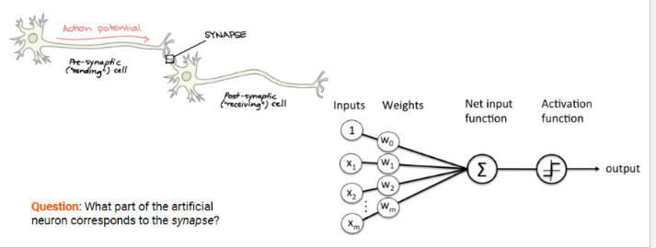
Classification Models – Percpetron
Perceptron – the first classifier
Introduced by Frank Rosenblatt in 1958 (psychologist)
Biological inspiration: synapses store memory
Donald Hebb (1949)
Knowledge and learning occurs in the brain primarily through the formation and change of synapses between neurons
Eric Kandel, Nobel prize 2000
Demonstrated the physiological basis of neural memory storage. i.e. that memories are stored in the strength of the synaptic connections

Slide 5
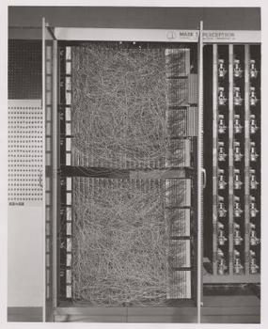
Percpetron – Example
The Mark I Perceptron: A machine designed for image recognition
Inputs: a 20 x 20 array of cadmium sulfide photocells
Weights: potentiometers controlled by motors for weight updates
"the embryo of an electronic computer that [the Navy] expects will be able to walk, talk, see, write, reproduce itself & be conscious of its existence” Rosenblatt about the Perceptron in 1958 (according to New York Times)
This contributed to a hype and subsequent AI winter
Source: Image credit: The Mark I Perceptron, by source (WP:NFCC#4), fair use, https://en.wikipedia.org/w/index.php?curid=47541432

Slide 6
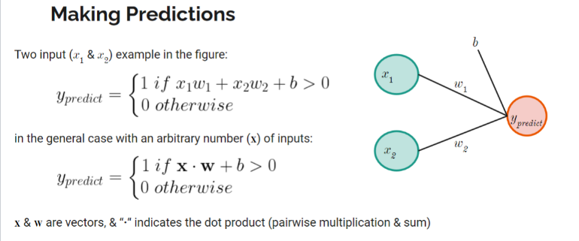
Percpetron – Example
Question: What is y predict if x1 = 0.5, w1 = 2, x2 = 2, w2 = 0.5 and b = -1?

Slide 7
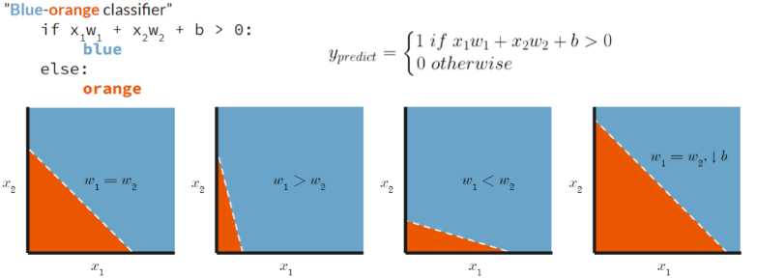
Percpetron – Example
Question: How is the colour blue/orange coded?

Slide 8
Learning in perceptorn
w1 (t+1) = w1 (t) + ɑ (y – y predict) x1; a= learning rate
If error is positive (y > y predict), then increase the weight → next time y predict will be bigger
If error is negative (y < y predict), then decrease the weight → next time y predict will be smaller

Slide 9
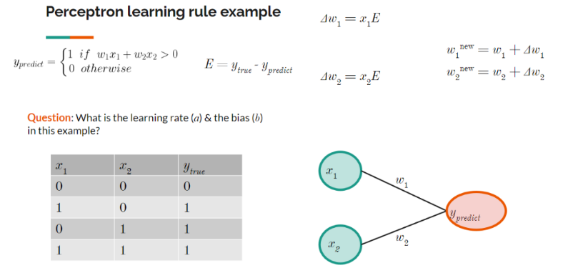
Example – Learning in perceptorn

Slide 10
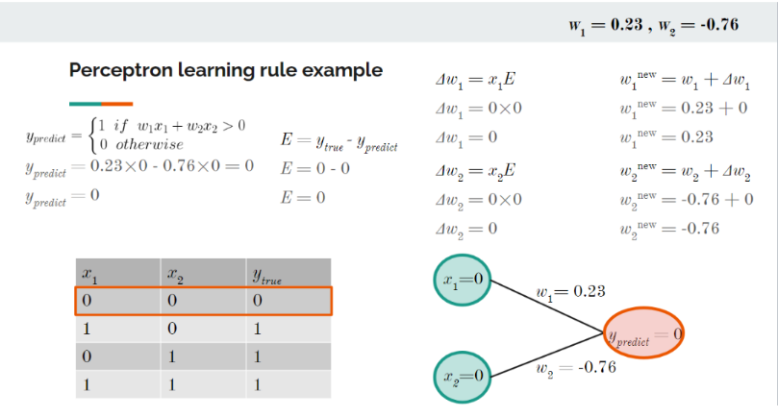
Example – Learning in perceptorn

Slide 11
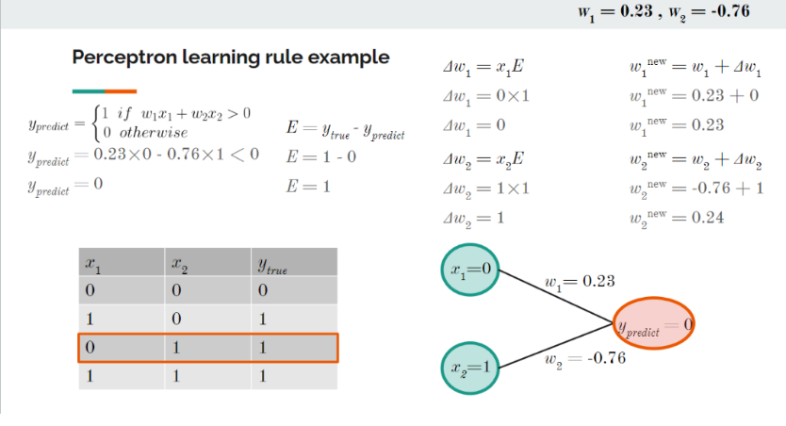
Example – Learning in perceptorn

Slide 12

Perceptorn – Applications
Linear classifier: Logistic regression or a linear SVM
Can separate inputs/objects with a linear decision boundary (i.e., a straight line or a flat hyperplane)
Source: Image credit: Cats & dogs by Elizabeth Goodspeed - CC BY-SA 4.0, https://commons.wikimedia.org/w/index.php?curid=40188333

Slide 13
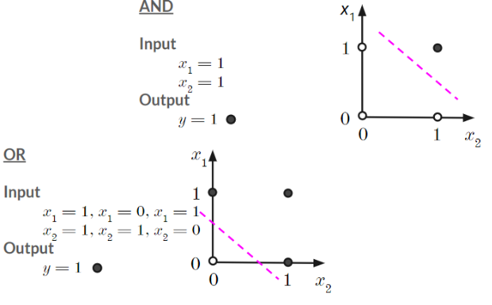
Perceptorn – Limitations
Perceptron is a Linear classifier – it cannot do nonlinear classification
Example: xor (exclusive or) classification
Input: (x1=1, x2=1); output y=1, else y=0
Input: ~ (x1=0, x2=0); output y=1, else y=0

Slide 14
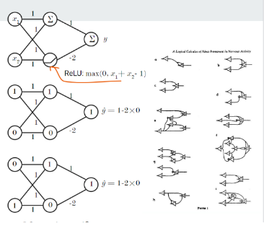
Perceptorn – Limitations
Mcculloch and Pitts (1943) showed that, for example, XOR classification could be achieved with multiple layers But, how to learn the weights in multi-layer networks?
The Perceptron learning-rule doesn’t work in multi-layer networks
Question: What are the outputs when inputs are x1 = 0, x2 = 0 & x1 = 1, x2 = 1?

Slide 15
Logistic Regression (classification / prediction of probability)

Slide 16
Agenda – Logistic Regression
Logistic Regression
Background and conceptual idea
Interpretation of logistic regression model
Estimation and Challenges
Applications
Choice and scoring models
Individual targeting (e.g., RFM models, etc.)

Slide 17
Logistic Regression
Estimate probability that an observation/case will fall into one of the groups based on a given set of independent variables
Examples
What is the probability of you purchasing a car based on specific values of its attributes (e.g., price, brand, safety rating, mileage, etc.)?
What is the probability of you voting for a candidate based on attributes and policy platform they propose?
What is the probability of you going to gym three times a week based on your personal and other attributes (e.g., age, motivation, etc.)?

Slide 18
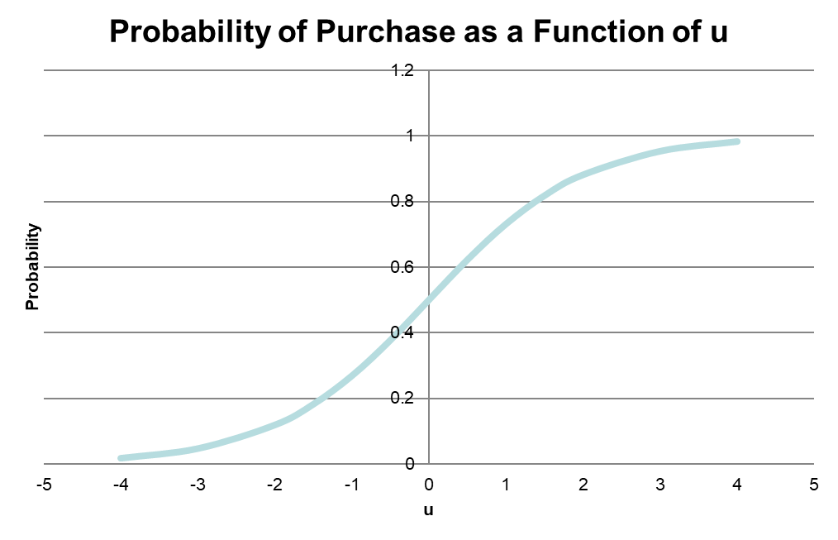
Logistic Regression
Binary Logit
Y is coded as (purchase =1 , not purchase =0)
Probability of consumer i buying the product is
U = value (or utility) of purchasing the product
U=0=value (or utility) of NOT purchasing the product
u is measured as a linear function of observable characteristics Xs
Xs = price, brand, demographics, etc.
α: measures influence of x on utility
positive: increase probability
negative: decrease probability
Algorithm will find the α coefficients that best “fit” the data in the sense they best “explain” the observed choices

Slide 19
Estimating logistic regression
Inputs: observed choice for customer i, product attributes Xs
Processing: Model estimated using logistic regression algorithm
Outputs of estimation
Estimated values and standard errors of α_{k}
Estimated impact of α_{k} → P_{ij}
Estimated choice probability P_{ij} or marginal impact of X on P

Slide 20
Linear Regression vs Logistics Regression
Can we use linear regression (LR) when DV y is categorical (y=0 if no purchase, y=1 if purchase) ?
Technical answer: predicted values might be outside (0,1) or (1,n)
Intuitive answer: Categorical variables are not on interval scale, which is a minimum requirement for linear regression to work? Why?

Slide 21
Applications – Logistic Regression
Choice Models: As the same suggests, choice models try to model our choice behaviour
When consumers make choices (e.g., purchase, voting, other behavioural choice – healthy lifestyle, using public transport, etc.), they focus on specific attributes / features of that choice (e.g., price, brand, convenience, favourable perception, etc.)
Assign different weights to different attributes in their final decision, i.e., not all attributes/features are valued equally
Choice models, based on observed data, try to separate and measure the influence of each attribute on the final choice

Slide 22
Choice Models – Activity
Select a category familiar to you
Think of three attributes that are important for that category (exclude price, history, reputation and brand name)
Give importance weights to each attribute such that total sum of weights must equal 10, no zero or negative values
Note the difference in weights assigned to attributes. Compare your weights to those assigned by other customers

Slide 23
Activity – Choice Model (Database Marketing)
Suppose you run the mailing operation for a major catalog firm. You have designed a new seasonal “Winter Catalog”.
You estimate the cost of mailing (including catalog and mailing cost) is $3. Currently you have a house list of 10,000 customers with past purchase records.
Average amount is $40
Response rate is 2%
Decision: How many customers you should send this catalog to? 0

Slide 24
Applications of Logistic Regression Recency, Frequency, and Money (RFM) Model

Slide 25
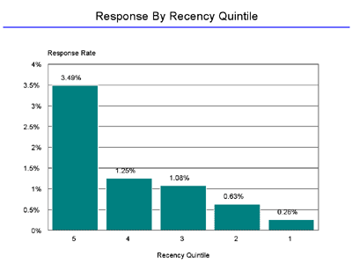
Recency and its importance
Recency: Time since last purchase, e.g., the most recent trip to Tim Horton was yesterday (or 3 months ago)
Example: A direct marketer mailed a new offer to 30,000 customers and received 402 responses. Response rate= 402/30,000 = 1.33%
Calculate average response rate based on recency score and sort them from smallest to largest, in quintile
5 groups, 30,000/5 = 6,000 customers in each group
The difference between the highest and lowest response rate is 3.49 / 0.26 = 13x

Slide 26
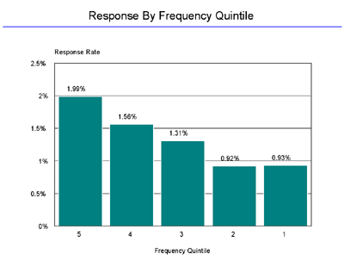
Frequency and its importance
Frequency: Number of purchases in a certain period, e.g., 3 visits (or 25 visits) to Tim Horton per month
Calculate average response rate based on frequency score and sort them from smallest to largest, in quintile
5 groups, 30,000/5 = 6,000 customers in each group
The difference between the highest and lowest response rate is 1.99 / 0.93 = 2x

Slide 27
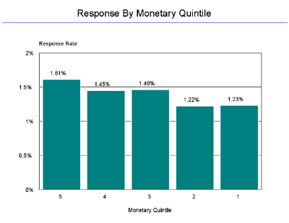
Amount and its importance
Money (or amount): Average amount per purchase, e.g., $5 vs $100 per visit to Tim Horton
Calculate average response rate based on average amount spent and sort them from smallest to largest, in quintile
5 groups, 30,000/5 = 6,000 customers in each group
The difference between the highest and lowest response rate is 1.51 / 1.23 = 1.2x

Slide 28
RFM cells – combining R, F, and M (5 x 5 x 5 = 125)
If using Quintile method, rank order 5×5×5 = 125 cells by response rate
Select cells with “high response rates”
Breakeven response rate:
Response Rate × Unit Profit Margin = Unit Mailing Cost
Quick profit increase “without statistics”!
RFM Cells | Response Rate
125 | 8.33%
124 | 6.66%
123 | 5.42%
122 | 4.17%
121 | 4.08%
… | 3.75%
… | 3.00%
… | 2.50%
3 | 1.17%
2 | 1.07%
1 | 0.54%

Slide 29
Model Based Individual Targeting – Lift Charts

Slide 30
Model Based Individual Targeting – Basic Method
Use a sample of customers that received mails
Estimate a model relating response (purchase) to individual-characteristics (RFM, demographics, etc.)
Use model estimates to compute an individual “score”: predicted purchase probability
Ask “what if questions”: what if I mail to top 10% (20%, 30%, 40%, 50%, …) customers based on score? Compute response rate.
Compute “lift” – increase of response rate
Compute profit-maximizing percentage of customers to target

Slide 31
Model Based Individual Targeting – Steps
Step 1: Create database of customer responses (choices) based either on test mailing to a sample of prospects/customers, or historical data of past customer purchases
Step 2: Use models such as regression, or RFM to assess the impact of independent variables (drivers) of customer response
Step 3: Score each customer/prospect based on the drivers identified in Step 2 - the higher the score, the more likely is the predicted response
Step 4: Classify customers into deciles (or smaller groupings) based on their scores
Step 5: Based on profitability analyses, determine the top deciles to which a marketing action (e.g., mailing of brochure) will be targeted

Slide 32
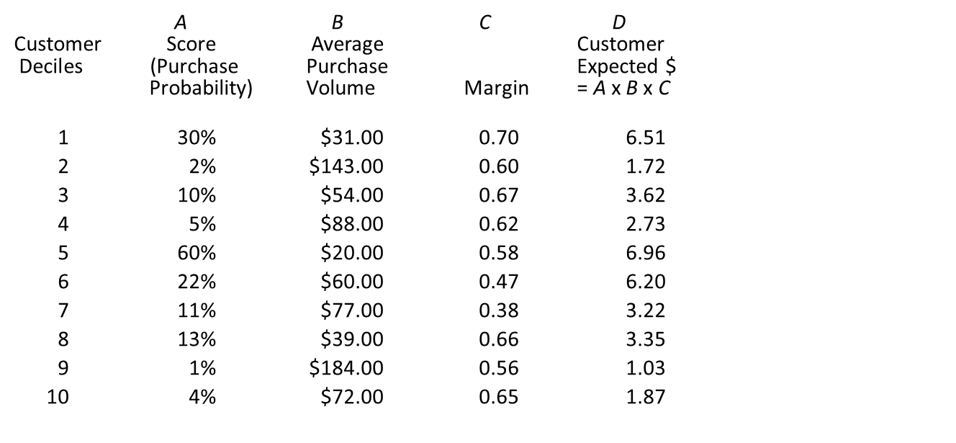
Example – Customer Scoring and Profitability

Slide 33
Naïve Bayes classifier

Slide 34
Naïve Bayes classifier
Naive Bayes Classifier: Given the probabilities of each class, how do we make a prediction?
Applied to text classification 1964 by Mosteller and Wallace (statisticians)
The Naive Bayes Classifier is a probabilistic classifier. i.e. it returns the probability of a class instead of the predicted class label (as the Perceptron does)
It estimates the conditional probability of a class given the data, i.e. p(class|data), or p(y|x)
Example: Given an email containing “$$$”, what is the probability that it is a spam?

Slide 35
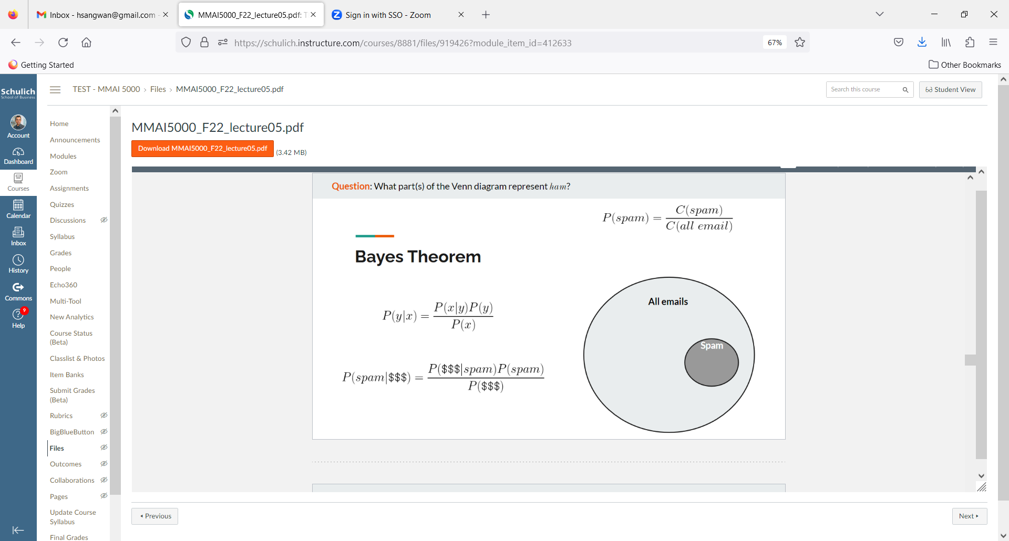
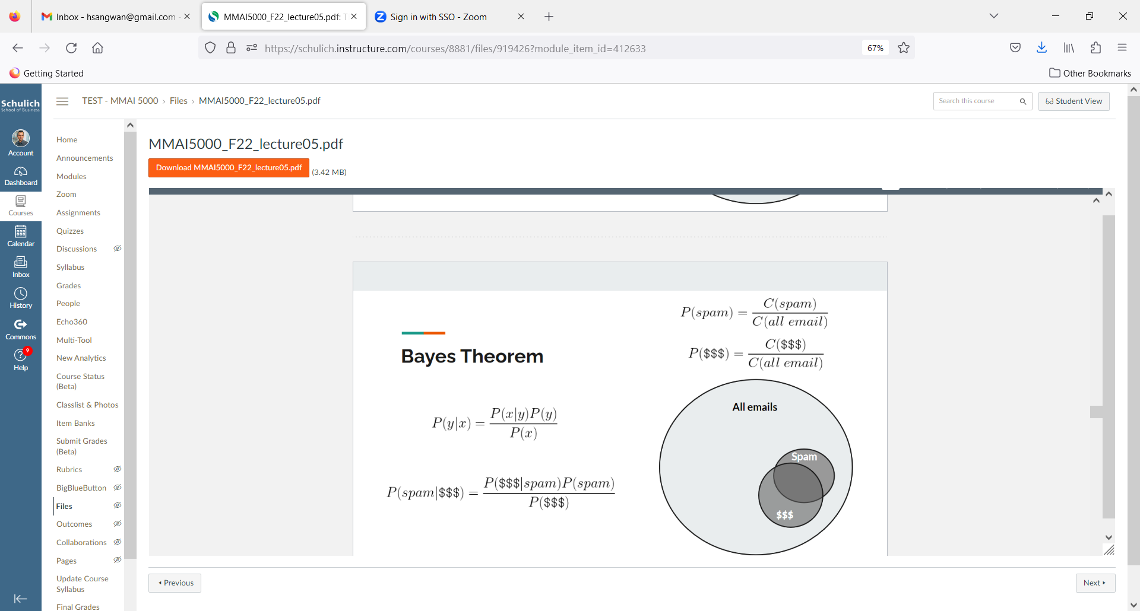
Naïve Bayes classifier
There is an email containing “$$$”, what is the probability it is a spam?
Bayes Theorem (15 minutes): https://youtu.be/HZGCoVF3YvM

Slide 36
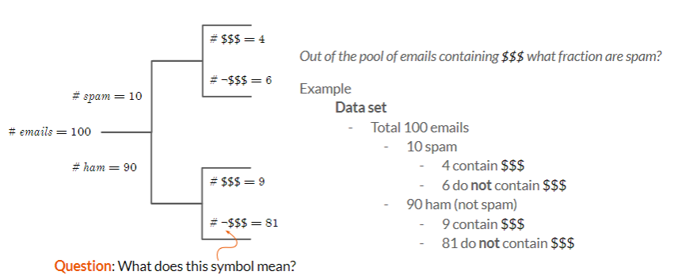
Naïve Bayes classifier
There is an email containing “$$$”, what is the probability it is a spam?
In what sense does a Naïve Bayes Classifier learn? What was learning in the example?

Slide 37
Multinomial Naïve Bayes classifier – classifier with multiple features
Multinomial Naïve Bayes Classifier: (“$$$”, “lottery”, …)
Multinomial Naive Bayes Classifier = P(f1, f2, ..., fn | c) = P(f1 | c)P(f2 | c) ... P(fn | c)
Assuming features are independent
Question: Is the Multinomial Naïve Bayes Classifier a linear classifier?

Slide 38
Generative vs Discriminatory Models

Slide 39
Generative models (vs discriminatory models)
Model the joint probability distribution: P(x1, x2, , ..., xn), P(x, y) or P(x, c)
Classification: generative vs discriminative, an intuitive example
Task: figure out what language someone is speaking
Generative approach: learn each language and determine which language best fits what is heard
Discriminative approach: Determine the linguistic differences between languages

Slide 40
Generative models (vs discriminatory models)
Model the joint probability distribution: P(x1, x2, , ..., xn), P(x, y) or P(x, c)
Classification: generative vs discriminative, an intuitive example
Task: figure out what language someone is speaking
Generative approach: learn each language and determine which language best fits what is heard
Discriminative approach: Determine the linguistic differences between languages

Slide 41
Classification – Generative (vs discriminatory models)
Classification: Given some input data x, what is the most probable class y? I.e. arg max P(y | x)
Generative approach
Learns the joint probability distribution, P(x, y) [also P(x & y) & P(x ∩ y)]
Classification is done by using Bayes Theorem to get P(y | x) from P(x, y) & P(y)
Can also be used to generate likely data (i.e. x, y pairs)
Examples:
Naïve Bayes, Hidden Markov Models, (HMM), Sigmoidal Belief Networks, Gaussian Mixture Models, N-gram LM, Neural LM, Generative Adversarial, Network (GAN; generative and discriminative), Variational Auto encoder (VAE)
Discriminative approach
Directly learns the conditional probability distribution P(y|x)
Examples:
Logistic/linear regression, SVM, traditional, neural networks, Decision Trees, Random Forests, XGBoost

Slide 42
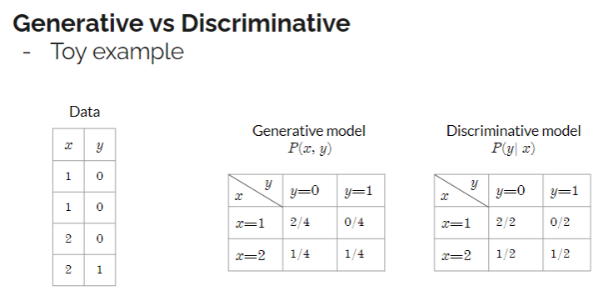
Classification – Generative (vs discriminatory models)
Example

Slide 43
Recommended Readings
Naïve Bayes. Retrieved from https://scikit-learn.org/stable/modules/naive_bayes.html
Naïve Bayes classifier. Retrieved from https://www.geeksforgeeks.org/naive-bayes-classifiers/
Top 10 Deep Learning Algorithms You Should Know in 2023. Retrieved from https://www.simplilearn.com/tutorials/deep-learning-tutorial/deep-learning-algorithm

